Slide 1
Guidelines for Kick Off Template
DELETE SLIDE BEFORE USING
How will this template help me?
We want to help teams establish governance structure, team norms, AWS ways of working, escalation paths, security guidelines, etc. Using this deck is expected to save 3-4 hours of prep time and provide a consistent kick off experience.
Do I have to use this template?
No, you are not required to use this template. It is offered as an aid to help guide you in the creation of project kick off material. Throughout the template, we provide several options that can be tailored for your specific engagement.
When would I use a kick off deck?
Materials in this deck are designed to support conversations with your customer about project governance. This may happen before contract signature or just after. Content in this kick off deck covers establishing escalation paths, security guidelines, tooling and ways of working that are agreed between AWS, the customer and partner.
Why are there different versions of the same slide, e.g. multiple roadmaps?
We provided multiple options within each section for you to pick a template that best works for your customer and your engagement. Remove what you do not use. Suggest new ones as you build new solutions.

Slide 2
AWS ProServe Kick Off

Slide 3
Welcome and introductions

Slide 4
Agenda

Slide 5
Engagement Team

Slide 6
Engagement Team
Work Stream | Role | Specialty | Activities

Slide 7
Program Structure
STEERING COMMITTEE
MIGRATION TEAM - US
AWS India Team
APPLICATIONS
[Name – Role]
[Name – Role]
[Name – Role]
[Name – Role]
[Name – Role]
[Name – Role]
[Name – Role]
[Name – Role]
[Name – Role]
[Name – Role]
[Name – Role]
[Name – Role]
[Name – Role]
[Name – Role]
[Name – Role]
[Name – Role]
[Name – Role]
[Name – Role]
[Name – Role]
[Name – Role]
MIGRATION - PMO
[Name – Role]
[Name – Role]
[Name – Role]
Legend
OPERATIONS TEAM
[Customer Name] ROLES
AWS ROLES
[Partner Name] ROLES
[Name – Role]

Slide 8
Activities and responsibilities
Activities | AWS | <Customer>

Slide 9
Workstreams leads
 | <Client> | AWS
<Work stream> | Name | Name
<Work stream> | Name | Name
<Work stream> | Name | Name
<Work stream> | Name | Name
<Work stream> | Name | Name
<Work stream> | Name | Name

Slide 10
<Customer > – AWS Team Organization
Program Leads
Champion Team
Architectural Review Board
AWS
Name
Name
Name
Customer
Name
Name
Name
AWS
Name
Name
Name
Customer
Name
Name
Name
AWS
Name
Name
Name
Customer
Name
Name
Name
Program Governance
AWS
Name
Name
Name
Customer
Name
Name
Name
Workstream
Discovery / Migration Planning
Platform / Landing Zone
Security / Compliance
Operations Integration
OCM / People
Migration
SAP
AWS Workstream Lead
Name
Name
Name
Name
Name
Name
Name
Customer Work Stream Lead
Name
Name
Name
Name
Name
Name
Name
Notes:
Speaker Notes:
Staffing Approach
To clarify our staffing approach, it is designed to be agile to deliver successful outcomes. If a need to ramp up in an area to complete a deliverable arises we will do so and have done so this during the program. When a deliverable is achieved and a milestone is closed, our staffing plans ramp down accordingly. We currently have 40 AWS consultants and 15 partner resources staffed on the CTP program. Since the program started, 7 AWS consultants have rolled off the program. Three of those were planned as part of a milestone completion, one was swapped out for a more senior resource with a specific skillset needed for the platform team, one was replaced in a response to 3M feedback that a more experienced program manager was desired and two left AWS (one was directly backfilled and the other is Guy Paradise, which we are looking to replace). Examples of ramping up staff to enable outcomes are: the addition of the Account Review Board (ARB) team, two additional Engagement Managers to cover work streams, two additional Cloud Architects to support the platform build out. We brought in one extra migration consultant at the beginning of the project to mitigate any gaps while our Migration lead is on Paternity leave along with a second senior migration resource to support the wave planning completion.
Strategic Program Management
We understand the concerns around the departure of Guy Paradise our Senior Program Lead (SPL) and gaps that may leave in coverage. While we look for Guy’s replacement, we have implemented coverage for the primary program functions to address risk to the program. The program management functions are being covered per the below:
· Guy was the program relationship owner with Kyle as the 3M Program Lead. Early in the program, we brought in LeeAnn Fitzsimmons, Senior Delivery Practice Lead, to work with Guy and Kyle. LeeAnn is now taking ownership of the relationship with Kyle to ensure we are able to quickly respond to any delivery related issues.
· The SPL is responsible to work with 3M on any change orders and additional SOW needs, Jim Wilcox is taking ownership of this.
· Guy was the primary interface with our partner Cognizant along with our Program Lead Laura Watts (Principal Engagement Manager). Laura is taking full ownership of the partner relationship and all resourcing requirements with Cognizant.
· To allow Laura Watts the ability to focus on the CTP as a whole, we have added two additional Engagement Managers (Olivia So and Ikraj Sangha) to support Laura. They will focus on individual work streams and Jira update activities.

Slide 11
Engagement Scope

Slide 12
Voice of Customer
<Name of the customer>

Slide 13
Engagement Roadmap
Kickoff
Activity
Activity
Activity
Activity
Closure
Sprint duration
Sprint duration
Sprint duration
Sprint duration
Sprint duration
Sprint duration
Activity description
Activity description
Activity description
Activity description
Activity description
Activity description
Notes:
[Optional]<use this slide when the engagement deliverables and milestones are clear throughout the engagement lifecycle, take the opportunity to provide your customer visibility on how the activities throughout the project will look like>

Slide 14
Engagement Roadmap
<Work Stream>
Week-2
Week-3
Week-1
<Activity>
<Activity>
<Activity>
<Activity>
<Activity>
<Activity>
<Activity>
<Activity>
<Activity>
<Activity>
<Activity>
<Activity>
<Activity>
<Activity>
<Activity>
<Work Stream>
<Activity>
<Activity>
<Activity>
<Activity>
<Activity>
<Activity>
<Activity>
<Activity>
<Activity>
<Activity>
<Activity>
<Activity>
<Activity>
<Activity>
<Activity>

Slide 15
Roadmap / Timeline
Yet to begin
In Progress
Complete
At Risk
Milestone
Jul | Aug | Sep | Oct | Nov | Dec
Workstream 1
Activity 1
Milestone 1
Activity 2
Milestone 2
Milestone 3
Activity 3
Milestone 4
Activity 4
Milestone 5
Activity 5
Milestone 6
Workstream 2
Activity 6
Activity 7
Activity 8

Slide 16
Business Value Roadmap - <Release Name>
<LRP Period | Work Stream 1 | WS Leader Name>
<High Level Description> Objectives: <Increase xyz> <Increase xyz> <Increase xyz>
Goals / Metrics: <Increase xyz> <Increase xyz> <Increase xyz>
Business Services: <Business Services 1> <Business Services 2> <Business Services 3> Features <Features 1> <Features 2> <Features 3>
<LRP Period | Work Stream 2 | WS Leader Name>
<High Level Description> Objectives: <Increase xyz> <Increase xyz> <Increase xyz>
Goals / Metrics: <Increase xyz> <Increase xyz> <Increase xyz>
Business Services: <Business Services 1> <Business Services 2> <Business Services 3> Features <Features 1> <Features 2> <Features 3>
<LRP Period | Work Stream 3 | WS Leader Name>
<High Level Description> Objectives: <Increase xyz> <Increase xyz> <Increase xyz>
Goals / Metrics: <Increase xyz> <Increase xyz> <Increase xyz>
Business Services: <Business Services 1> <Business Services 2> <Business Services 3> Features <Features 1> <Features 2> <Features 3>
<LRP Period | Work Stream 4 | WS Leader Name>
<High Level Description> Objectives: <Increase xyz> <Increase xyz> <Increase xyz>
Goals / Metrics: <Increase xyz> <Increase xyz> <Increase xyz>
Business Services: <Business Services 1> <Business Services 2> <Business Services 3> Features <Features 1> <Features 2> <Features 3>
Business Objectives
OKRs
Business Services
Epic (Deliverable)

Slide 17





Work-Stream Snapshot – <Pod Name>
Customer Logo
Customer Lead: <Lead Name>
AWS Lead: <AWS Lead, AWS EM>
Work-stream Goal
<Insert goal of pod. See Outcome Alignment Canvas for content.>
We are here
Sprint 15
26 Apr – 7 May
Sprint 16
10 May – 21 May
Sprint 17
24 May – 4 Jun
Sprint 18
7 Jun – 18 Jun
Sprint 19
21 Jun – 2 Jul
Sprint 20
5 Jul – 16 Jul
Y
Y
G
G
Epic Description
Epic Description
Epic Description
Epic Description
Epic Description
Epic Description
Epic Description
Epic Description
Epic Description
Epic Description
Epic Description
Epic Description
Epic Description
Epic Description
Epic Description
Epic Description
Epic Description
Epic Description
Epic Description
Epic Description
Epic Description
Epic Description
Epic Description
Epic Description
Epic Description
Epic Description
Highlights
<Highlight>
<Highlight>
<Highlight>
Current Risks
<Risk>
<Risk>
Key:
Completed
Inprogress
At Risk
Blocked
R
G

Slide 18

Work Stream
Customer Lead:
AWS Lead:
Sprint 1
04 Nov – 17 Nov
Sprint 2
18 Nov – 01 Dec
Sprint 3
02 Dec – 15 Dec
Sprint 4
16 Dec – 29 Dec
Epic
Epic
Epic
Epic
Epic
Epic
Epic
Epic
Epic
Epic
Epic
Epic
Epic
Epic
Epic
Note: Roadmaps reflect plans created by the teams based on the best knowledge of prioritization, capacity, and issues/risks during LRP events on xxx date.

Slide 19
Roadmap
 | Contract Signed July 7th | Sprint 0 July 11th – July 17th | Sprint 0 July 18th – July 24th | Sprint 1 Jul 25th – July 31st | Sprint 2 August 1st – August 7th | Sprint 3 August 8th – August 14th | Sprint 4 August 15th – August 21st | Sprint 5 August 22nd – August 28th | Sprint 6 August 29th – September 4th | Sprint 7 September 5th – September 11th | Sprint 8 September 12th – September 18th | Sprint 9 September 19th – September 25th | Sprint 10 September 26th – October 1st
Discovery Workshops
Milestone 1
Milestone 2
Milestone 3

Slide 20
 | January |  | February |  |  |  | March |  |  |  | April
 | Sprint 1 | Sprint 2 | Sprint 3 | Sprint 4 | Sprint 5 | Sprint 6 | Sprint 7 | Sprint 8 | Sprint 9 | Sprint 10 | Sprint 11 | Sprint 12 | Sprint 13 | Sprint 14
Launch Ready Planning (LRP)
AWS Accounts and Tools Access
Landing Zone
AWS Control Tower
Account Strategy & Implementation
Network Integration
SSO Integration
CI/CD Tool Integration
Security Baseline and Optimization
Infrastructure Security
Log Aggregation & Analysis
Alerting & Security Dashboard
Incident Response
Distribution Service Migration
Collector Applications
LRP
Today

Slide 21

"Focusing on Customer Outcomes allows us to define success through the customer's eyes based on their unique priorities and business drivers"
Notes:
Customer Business Outcomes Wiki, https://w.amazon.com/bin/view/AWS/Teams/Proserve/CustomerBusinessOutcomes/
This quote describes Amazon’s approach to engaging with customers.
<read it out>
That is key to everything we do in Amazon because the emphasis is on Customer Outcomes. We have found that by focusing on our customers’ wants and needs we find ways to innovate and provide high value to them. We have a mechanism called working backwards that helps us do that and we like to use a light version of that at the start of our proserve engagements to make sure we’re set up for success. We’ll touch on this more shortly.
With that in mind, we’re keen to ensure we have a clear understanding of what it is you’re trying to achieve, and where you’re looking for AWS to help – would you mind giving us a brief overview?
<Potential follow-up questions could include:
Who are the key stakeholders – particularly those who own the scope of the work
What do they need, how have you found that out
Are there any compelling deadlines?
What does success look like to you, and your users?
How will you measure success?
What risks/ or issues do you see?
Are you aware of any constraints we should be aware of?>
Finish by briefly summarising back to the customer what you have heard. This should cover both what they are trying to achieve, and what help they need from AWS>

Slide 22
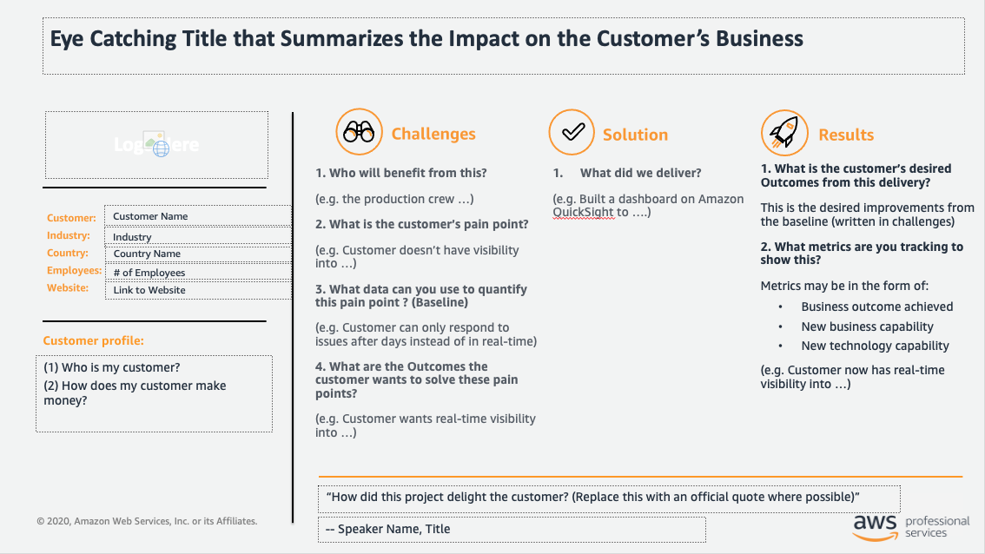
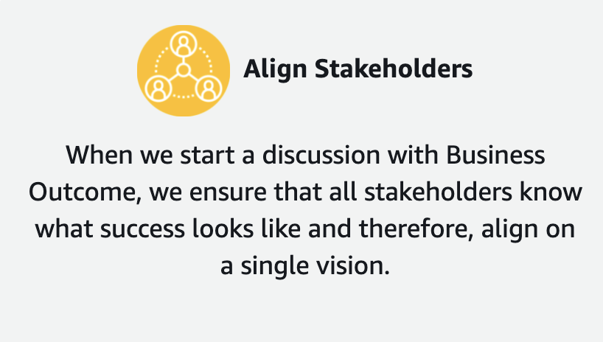
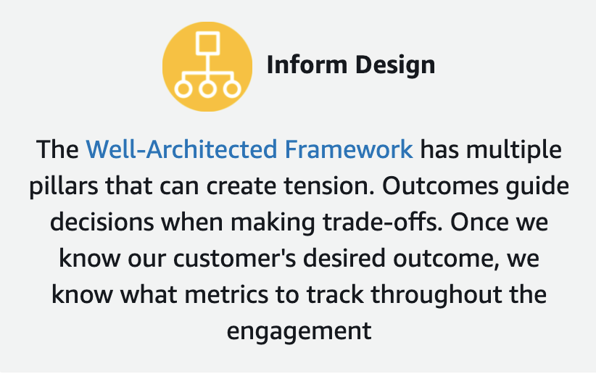
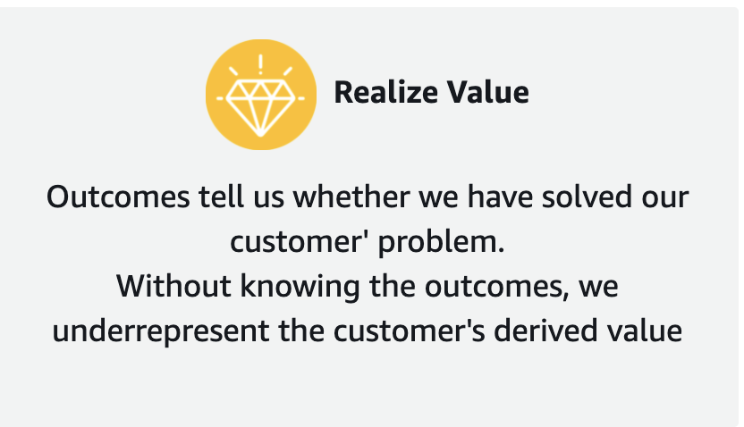
Alignment Outcome Canvas
Notes:
Customer Business Outcomes Wiki, https://w.amazon.com/bin/view/AWS/Teams/Proserve/CustomerBusinessOutcomes/
What are Customer Business Outcomes?
Our customers wants to grow its business, increase its productivity, reduce cost, or reduce risk. Business outcomes are the measurable impact on the way the customer makes money, and they define why the customer wants to implement AWS. Successfully helping our customers achieve their desired business outcomes can strengthen their business case and accelerate their digital transformation. Helping our customers achieve their desired business outcomes is what makes AWS a trusted business partner, not just a solutions vendor.

Slide 23
1. Who will benefit from this?
(e.g. the production crew …)
2. What is the customer’s pain point?
(e.g. Customer doesn’t have visibility into …)
3. What data can you use to quantify this pain point ? (Baseline)
(e.g. Customer can only respond to issues after days instead of in real-time)
4. What are the Outcomes the customer wants to solve these pain points?
(e.g. Customer wants real-time visibility into …)
What did we deliver?
(e.g. Built a dashboard on Amazon QuickSight to ….)
1. What is the customer’s desired Outcomes from this delivery?
This is the desired improvements from the baseline (written in challenges)
2. What metrics are you tracking to show this?
Metrics may be in the form of:
Business outcome achieved
New business capability
New technology capability
(e.g. Customer now has real-time visibility into …)
Notes:
Customer Business Outcomes Wiki, https://w.amazon.com/bin/view/AWS/Teams/Proserve/CustomerBusinessOutcomes/

Slide 24
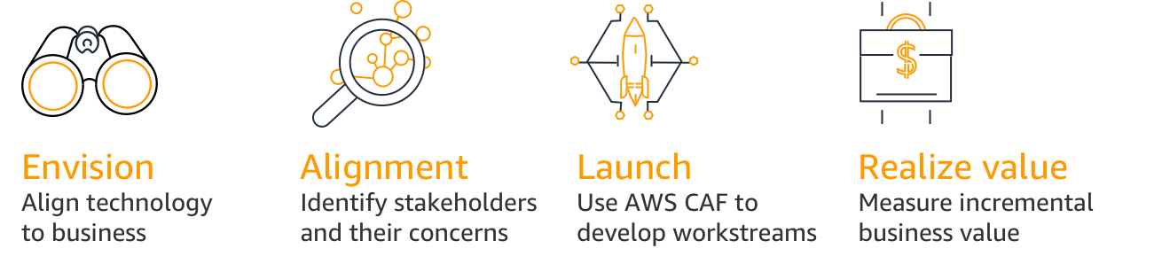
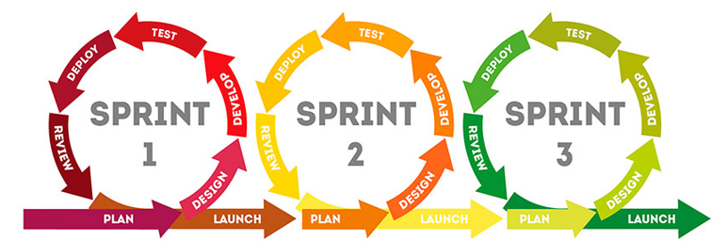









AWS Ways of Working, Unless You Know a Better Way
Working Backwards
Cloud Adoption Framework (CAF)
Agile Delivery Framework
Press
Release
FAQs
Visuals
Vision
Road Map
Sprint
Two Pizza Teams
Iterative Delivery for Value Delivery
Backlog
(Epics/Stories)
Business Outcomes
One-way &Two-way Doors
Well Architected Framework
LRP – Lift Off
Operational
Excellence
Security
Reliability
Performance
Efficiency
Cost
Optimization
LRP
Roadmap
Collaboration

Slide 25






Chime Housekeeping Items
Have a question?
Send it via the chat feature in Chime and we will create a parking lot!
If you are not speaking please mute your line to decrease background noise!
Use the ‘raise hand’ feature in Chime during a topic if you have input!
Let’s embrace this virtual meeting – if you are able to, turn on your video!
Add a ‘thumbs up’ in the Chime chat to validate/agree with a topic or question!
Please be patient with any connectivity issues we may experience!

Slide 26

Team Norms
Team Norms are created and enforced by the team and are often revisited and improved upon during the Retrospective event for teams. Team Norms guide team members in their day to day work reducing and removing potential points of friction while supporting a high bar for quality and collaboration.
Definition of Done
Definition of Ready
Tenets
Inclusive Language
Working Agreements
Logistics
Notes:
Team Norms Wiki, https://w.amazon.com/bin/view/AWS/Teams/Proserve/Delivery/teamnorms/
Teams often set Team Norms also known as Working Agreements that set boundaries for how individuals will work together as a team. Team Norms are created and enforced by the team and are often revisited and improved upon during the Retrospective event for teams. Team Norms guide team members in their day to day work reducing and removing potential points of friction while supporting a high bar for quality and collaboration.
Team Norms apply to the entire delivery team including the customer, partner, AWS ProServe, and often AWS SA/TAM teams.

Slide 27
Team Norms to get your started
If it wasn’t written down ... it never happened.
If information doesn’t come from the source of record (SOR) ... do not use it.
People can be SOR’s, too.
We will say what we are going to do ... and then do it.
We begin every meeting with “what is the purpose of this meeting?”
Everyone’s opinions count.
We will be supportive rather than judgmental.
We will stay focused on our goals and avoid getting sidetracked.
We will freely share information upwards, downwards and peer-to-peer.
It’s our job to identify and communicate issues and/or concerns.
Bad news delivered late can be career limiting.
If we find ourselves repeating a task, we will document the steps (leave bread crumbs) and look to mechanize it.
Work will be transparent and available to all for inspection and validation.
We apply Two-Way Door decision making.
Notes:
Team Norms Wiki, https://w.amazon.com/bin/view/AWS/Teams/Proserve/Delivery/teamnorms/
Teams often set Team Norms also known as Working Agreements that set boundaries for how individuals will work together as a team. Team Norms are created and enforced by the team and are often revisited and improved upon during the Retrospective event for teams. Team Norms guide team members in their day to day work reducing and removing potential points of friction while supporting a high bar for quality and collaboration.
Team Norms apply to the entire delivery team including the customer, partner, AWS ProServe, and often AWS SA/TAM teams.

Slide 28

Definition of Ready (DoR) & Definition of Done (DoD)
Definition of Ready (DoR)
The definition of ready defines when a story is ready to bring forward into the Planning Ceremony. To borrow a phrase from Michael Cohn, the definition of ready acts as the bouncer checking that stories are clearly defined, have acceptance criteria, and a “buyer” identified. A definition of ready ensures that we know who we are doing the work for (buyer), we know when the story is complete (acceptance criteria), and we have a general sense of the work being requested (clear definition).
Definition of Done (DoD)
The definition of done defines what must be true of a story for it to be done. Each team member holds themselves as well as their peers to the definition of done ensuring high delivery quality.
Many stories completed by the team have follow up dependencies such as sign off from stakeholders before they can be truly marked as done. In these situations the consultant will mark the story as "In Review" in the sprint and create follow up task to track the outstanding activity.
Notes:
See Definition of Done and Definition of Ready wiki for more details and recommendations for DOR and DOD to get your team started, https://w.amazon.com/bin/view/AWS/Teams/Proserve/Delivery/teamnorms/#HDefinitionofReady26Done
Story: Story deliverables: Each story may have 1 or more of these components:
Code checked in and reviewed by a peer
Stakeholders including the buyer have reviewed and accepted the work
Unit test passed
Documentation / Diagrams updated and published on the project Repo
Operations is integrated
Security is integrated
Solution demonstrated to the buyer in non-production environment
Acceptance criteria verified complete by the buyer
Sprint:
Here are examples of how a team establish team norms for sprint and story management:
Team members mark all completed sprint stories as “Done” (in Jira).
Backlog updated
Burndown and velocity reports run and communicated to teams
Retro is completed and outcomes documented and published to wiki
A Well Architected Review is conducted at the end of major build phases

Slide 29
Definition of Done (DoD) Example
Story: Story deliverables: Each story may have 1 or more of these components:
Code checked in and reviewed by a peer
Stakeholders including the buyer have reviewed and accepted the work
Unit test passed
Documentation / Diagrams updated and published on the project Repo
Operations is integrated
Security is integrated
Solution demonstrated to the buyer in non-production environment
Acceptance criteria verified complete by the buyer
Sprint:
Here are examples of how a team establish team norms for sprint and story management:
Team members mark all completed sprint stories as “Done” (in Jira).
Backlog updated
Burndown and velocity reports run and communicated to teams
Retro is completed and outcomes documented and published to wiki
A Well Architected Review is conducted at the end of major build phases
Notes:
See Definition of Done and Definition of Ready wiki for more details and recommendations for DOR and DOD to get your team started, https://w.amazon.com/bin/view/AWS/Teams/Proserve/Delivery/teamnorms/#HDefinitionofReady26Done
Story: Story deliverables: Each story may have 1 or more of these components:
Code checked in and reviewed by a peer
Stakeholders including the buyer have reviewed and accepted the work
Unit test passed
Documentation / Diagrams updated and published on the project Repo
Operations is integrated
Security is integrated
Solution demonstrated to the buyer in non-production environment
Acceptance criteria verified complete by the buyer
Sprint:
Here are examples of how a team establish team norms for sprint and story management:
Team members mark all completed sprint stories as “Done” (in Jira).
Backlog updated
Burndown and velocity reports run and communicated to teams
Retro is completed and outcomes documented and published to wiki
A Well Architected Review is conducted at the end of major build phases

Slide 30
Inclusive Meeting Tips
Credit the Ideas of Others
Create an Opening for Others
Dial in Your Colleagues
Include Your Remote Callers
Recognize Efforts
Optimize Meeting Times for Required Attendees
Ask for Others' Opinions First
Allow for Processing Time
Help Others
Notes:
Inclusive Meeting Tips, https://w.amazon.com/bin/view/AWS/Teams/Proserve/Delivery/teamnorms/#HInclusiveMeetingTips
Poster: https://drive.corp.amazon.com/documents/solaskip@/Inclusive%20Meeting%20Tips/Inclusive%20Meeting%20Tips%20for%20Employee%20Reference%20FINAL.pdf
Credit the Ideas of Others
If I observe someone repeat an idea previously shared by another an get credit for it, then I'll verbally acknowledge the contribution of both individuals
Create an Opening for Others
If I observe someone dominating a conversation to the point that others can't contribute, then I'll redirect the conversation to other participants
Recognize Efforts
If I see someone demonstrating inclusive meeting practices, then I'll positively recognize and reinforce them
Help Others
If I observe someone not following our inclusive meeting guidelines, then I'll bring it up to them in an appropriate setting
Dial in Your Colleagues
If I own a meeting, then I will ensure a conference line or VC is set up for the meeting
Include Your Remote Callers
If there are participants on a conference line, then I'll write their names on a white board or a paper in the middle of the table
Optimize Meeting Times for Required Attendees
If I own a meeting (particularly a recurring meeting), then I'll ask for availability first and schedule the meeting to optimize the attendance of required attendees
Ask for Others' Opinions First
If I am one of the more senior leaders in a discussion, then I'll ask others their opinion of ideas prior to sharing my own in order to learn what others think.
Allow for Processing Time
If I own a meeting with a document to review and discuss, then I will try to send 24 hours in advance as a pre-read.
If I need to provide the document in the room, then I’ll take questions and feedback for a communicated period of time after the meeting.

Slide 31
Inclusive Language
In our daily work and life, we may unconsciously encourage bias by using words and phrases that have historical context and implications of which we may not be aware. Here are some common terms that used frequently on engagements and recommended alternatives that we can adopt to be more inclusive.
Biased Phrasing | Alternatives
Blacklist | DenyList Exclusion list Unapproved Deny list
Whitelist | Allow List Inclusion list Approved Allow list
Master | Primary Central Active Coordinator Leader Controller
Slave | Replica Secondary Follower Responder
Brown bags | Lunch and learn, Tech Talks
Man hours | Hours of effort
Pow wow | Huddle, Standup, Discussion
Grandfathered | Legacy, Exempt
“Hi Guys” | Y’all, Folks, Team
Black / Gray days | Blocked / Restricted days
Tribal knowledge | Institutional knowledge
Open the kimono | Full disclosure, Provide insight into
War Room | Team Breakout, Team Huddle Room, Team Planning Room
Notes:
Inclusive Language, https://w.amazon.com/bin/view/AWS/Teams/Proserve/Delivery/teamnorms/#HInclusiveLanguage

Slide 32
Engagement Tooling
Remote teams rely heavily on communication and collaboration tools for virtual delivery
Discover Customer’s preferred tooling
Share Amazon recommended tooling
On board team to tools
Function | Customer Preferred Tooling | AWS Tools + Preferred Solutions
Online Meetings + Video Conferencing |  | Amazon Chime
Chat + Chatrooms |  | Amazon Chime, Slack
Code Repo |  | Amazon Code Commit
Collaborative Workspace |  | Confluence
Diagramming + Work Flow Diagramming |  | Draw.IO drawio.corp.amazon.com/
Backlog Management |  | Jira
Document Management |  | WorkDocs
Access to AWS Corporate Network from a company laptop |  | AWS VPN
Access to corporate tooling from a trusted device (mobile, pad etc) |  | Amazon Enterprise Access (AEA)
Clickable Prototyping + Feedback |  | InVision
UI Design Source Control |  | Abstract
Notes:
Engagement Tooling wiki, https://w.amazon.com/bin/view/AWS/Teams/Proserve/Delivery/Tooling/
Recommendation: Review the Statement of Work (SOW) to confirm if engagement tooling has been defined in the SOW.

Slide 33
Escalation Path
We escalate early and often to raise visibility to issues, clear blockers, and bring in additional support to help our teams deliver customer outcomes.
Level | Type | Name
4th Level | Sponsor | Issues that require executive level support to resolve. {Name, Position}
3rd Level | Escalation Team | Issues that require mid level management or steering committee support. This may include the Cloud Center of Excellence or other governing body. {Name, Position}
2nd Level | Oversight Team | Issues that require next level support. This is typically the team leads and engagement lead. {Name, Position}
1st Level | Engagement Team | Is the issue one that the team can resolve on their own? {Name, Position}
Notes:
We escalate early and often to raise visibility to issues, clear blockers, and bring in additional support to help our teams deliver customer outcomes.
Escalation Path Wiki, https://w.amazon.com/bin/view/AWS/Teams/Proserve/Delivery/EscalationPath/

Slide 34
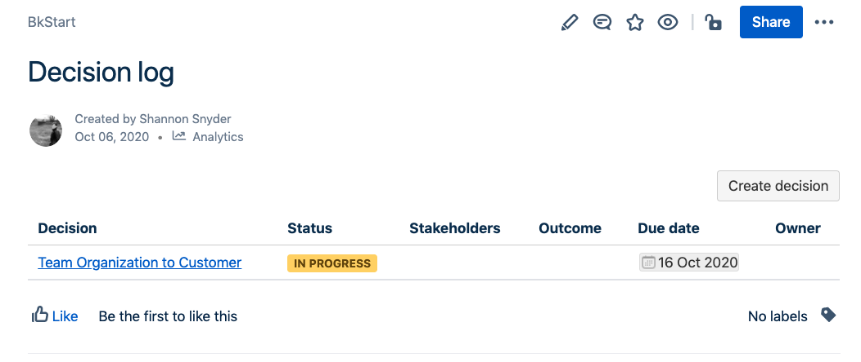
Decision Tracking
We use a Decision Log to share ideas, evaluate options, and keep track of decisions.
Entire team has visibility to decisions
Alignment to stakeholder(s)
Provides opportunities to collaborate and evaluate options
Additional information on Confluence Decision Tracking
Notes:
RAID LOG WIKI, https://w.amazon.com/bin/view/AWS/Teams/Proserve/Delivery/RAID/

Slide 35
Prioritization
Before developing a solution, we work backwards from the customer. In our agile framework we ensure that every story has a buyer who prioritizes the work and provides the acceptance criteria.
In sprint planning we confirm that every story has a buyer (prioritization)
In sprint review, we confirm buyer acceptance (feedback)
Buyer – Seller Exchange
Buyer
Seller
Responsible for specifying acceptance criteria
Validating and meeting acceptance criteria

Slide 36
Communication & Coordination
AWS Best Practice
All work is visible and available to the entire team
Align status reporting & financial reporting to sprint cadence
Roadmaps are refreshed at least once per quarter
Demo together to provide visibility across tracks
AWS Requests to <customer>
On boarding / off boarding & tooling
Distribution lists for status & financial reporting
”Buyer” participation in Planning & Demos
Notes:
What information do you (customer) need from AWS in order to on board consultants?
What is the expected turn around time for on boarding?
Where can we create and manage communication protocols including team member names, contact details as well as distribution lists for the team, for status, and for financial reporting (smaller distribution)?
Supporting Wikis:
Sprint 0, https://w.amazon.com/bin/view/AWS/Teams/Proserve/Delivery/PDP/Sprint0/

Slide 37
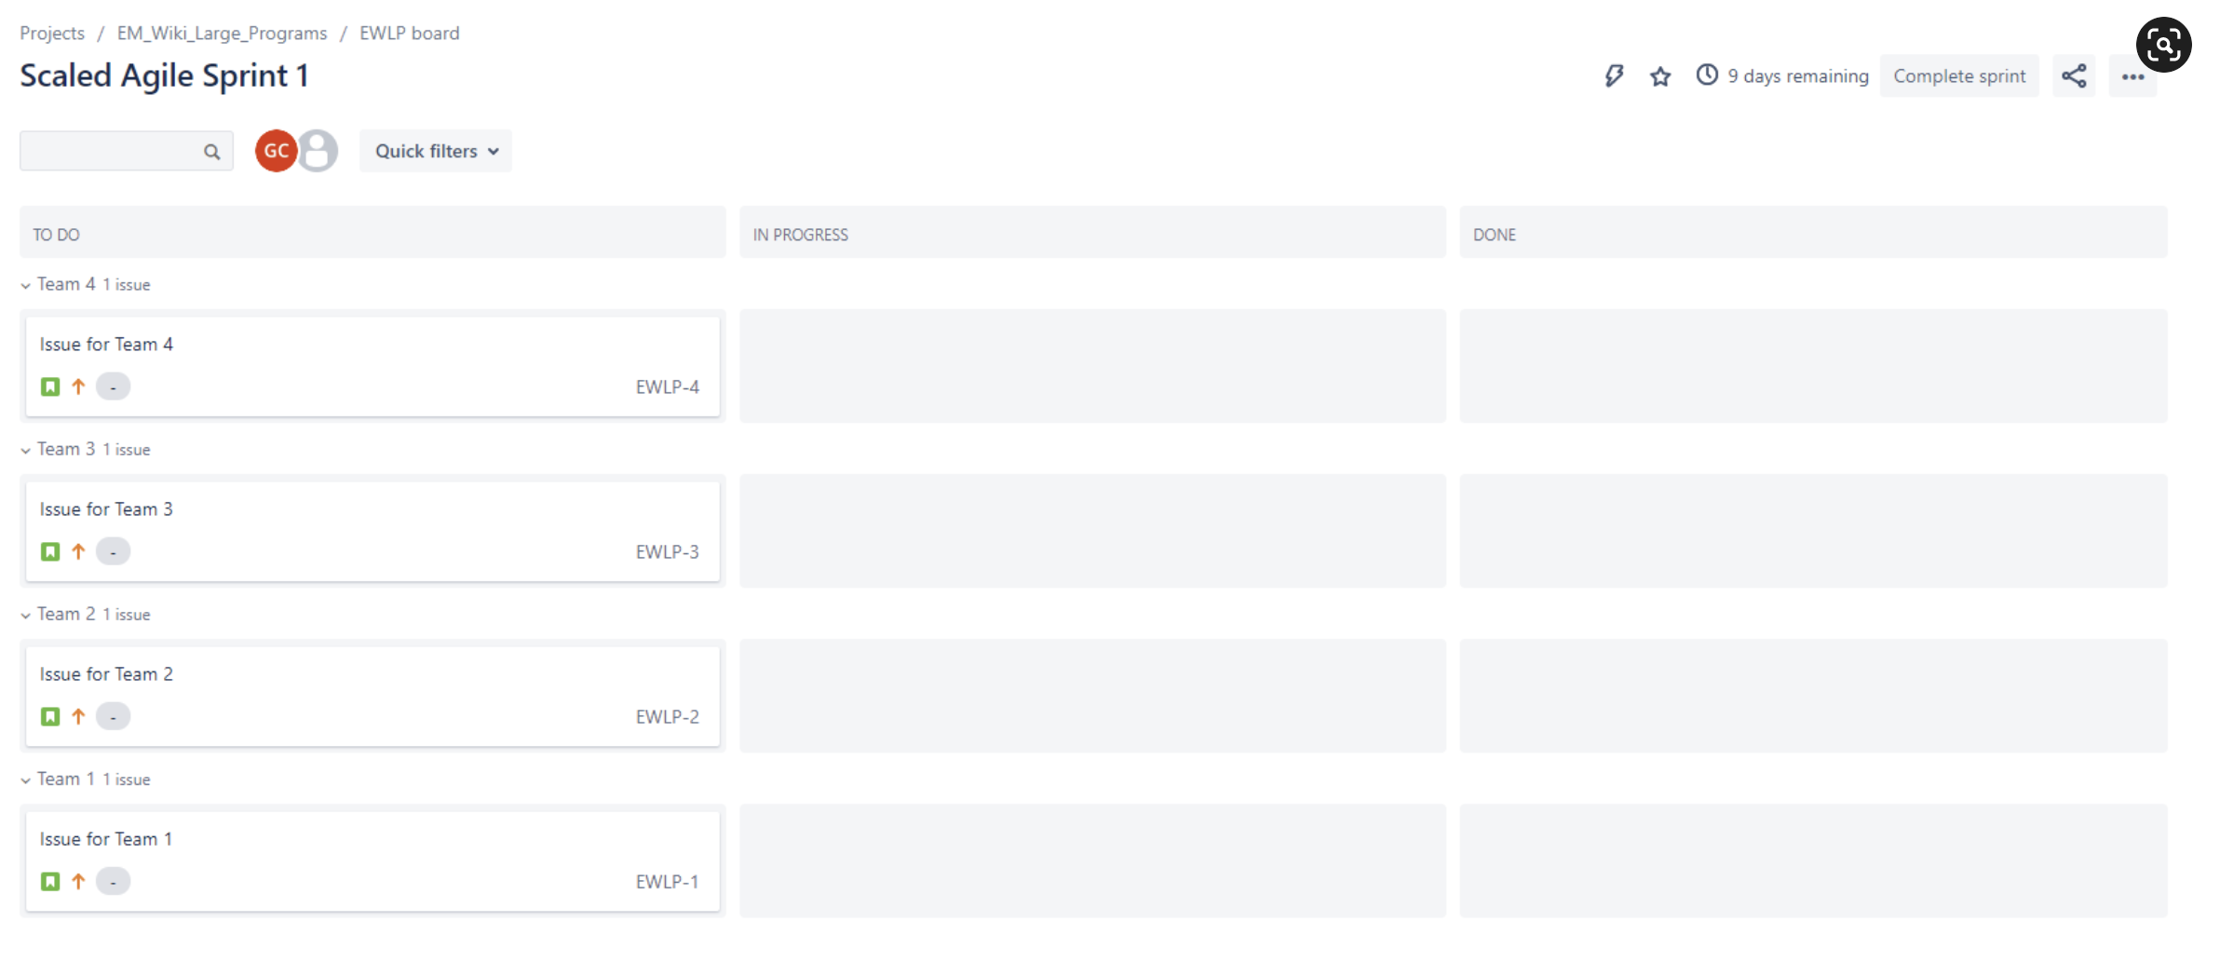
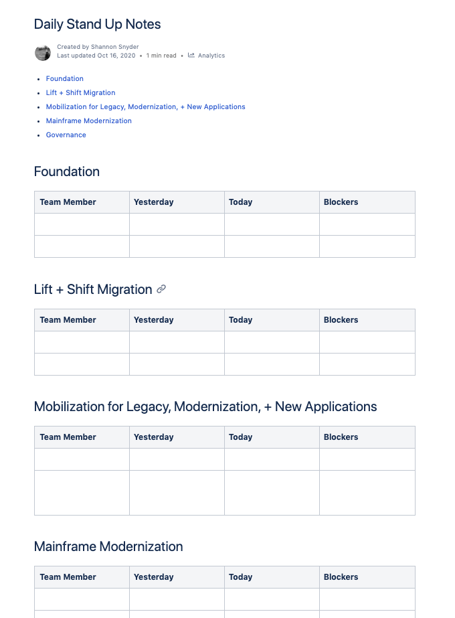
Mechanisms to encourage collaboration and visibility
Notes:
All work is visible to the entire team
Commitments for planning are visible to all team members on a single Sprint Planning page, Daily Stand Up Notes, etc.
Jira for Large Programs, https://w.amazon.com/bin/view/AWS/Teams/Proserve/Delivery/JiraLargePrograms/

Slide 38
Scrum Events
ET | Monday | Tuesday | Wednesday | Thursday | Friday
09:00 AM | 09:00 - 09:15 Daily Standup | 09:00 - 09:15 Daily Standup | 09:00 - 09:15 Daily Standup | 09:00 - 09:15 Daily Standup | No Meetings
10:00 AM | Working session | Working session | Working session | Working session
11:00 AM | Working session | Working session | Working session | Working session
12:00 PM | Lunch | Lunch | Lunch | Lunch
01:00 PM | Working session | Working session | Working session | Working session | Please use this time to clear your backlog
02:00 PM | Working session | 02:00 - 03:30 Demo, Retro & Sprint Planning | 2:00 - 02:30 Weekly Status Meeting | 2:00 - 02:30 Weekly Team Meeting
 |  |  | 2:30 - 03:00 Weekly Executive Review
03:00 PM | Working session | Working session | Working session | Working session
04:00 PM | Working session | Working session | Working session | Working session

Slide 39
Scaling Teams
 | Thur | Fri | Mon | Tue | Wed | Thur | Fri | Mon | Tue | Wed
T1 | D:9-9:15 | D:9-9:15 | D:9-9:15 | D:9-9:15 Rep:1-1:45 | Rev:9-9:30 Ret:1-1:30 P:1:30-2:30 | D:9-9:15 Status(30) | D:9-9:15 | D:9-9:15 | D:9-9:15 Rep:1-1:45 | Rev:9-9:30 Ret:1-1:30 P:1:30-2:30
T2 | D:9:15-9:30 | D:9:15-9:30 | D:9:15-9:30 | D:9:15-9:30 Rep:2-2:45 | Rev:9:30-10:00 Ret:1-1:30 P:1:30-2:30 | D:9:15-9:30 Status(30) | D:9:15-9:30 | D:9:15-9:30 | D:9:15-9:30 Rep:2-2:45 | Rev:9:30-10:00 Ret:1-1:30 P:1:30-2:30
T3 | D:9-30-9:45 | D:9-30-9:45 | D:9-30-9:45 | D:9-30-9:45 Rep:3-3:45 | D:9-30-9:45 | D:9-30-9:45 Status(30) | D:9-30-9:45 | D:9-30-9:45 | D:9-30-9:45 Rep:3-3:45 | Rev:10:00-10:30 Ret:1-1:30 P:1:30-2:30
T4 | D:9-45-10:00 | D:9-45-10:00 | D:9-45-10:00 | D:9-45-10:00 Rep:4-4:45 | Rev:10:30-11:00 Ret:1-1:30 P:1:30-2:30 | D:9-45-10:00 Status(30) | D:9-45-10:00 | D:9-45-10:00 | D:9-45-10:00 Rep:4-4:45 | Rev:10:30-11:00 Ret:1-1:30 P:1:30-2:30
Heartbeat stays constant; teams decide their cadence. All synchronized.
D=Daily; Rep=Replenish; Rev=Review; Ret=Retro; P=Plan;

Slide 40




Ways to Provide Feedback
Sprint Reviews
At demo work at the end of every sprint to share what the team has accomplished. The purpose of the demo is to elicit feedback, share results, and assess progress toward outcomes.
Team
Pulse
At AWS, our goal is to exceed expectations and identify areas where we can improve for our customers. To support this goal, we built a portal for our customers to quickly and easily provide feedback. Each consultant has a Pulse Link in their email signature.
Consultant
Feedback Mechanism Frequency Scale
Customer Frequent Feedback
We care deeply about our customers and want to hear from them about what is going well and where we need to improve. Frequent and open feedback with the customer is a valuable tool that engagement teams use to identify blind spots throughout the engagement keeping a pulse on customer happiness.
Team
Customer Satisfaction (CSAT)
Typically sent at engagement closure, our CSAT survey is an opportunity for customers to share how we performed against their expectations.
Program Overall

Slide 41
Change Management Process Cycle
Task definition: Jira
Implementation: Feature branch in GitHub
Code peer review via PR: GitHub
Customer code review via PR: GitHub
Code merged to test branch: GitHub
Build code, deploy to Test: Jenkins
Testing (manual + automated)
Code merged to mainline and deployed to Prod
Task scheduling: Jira
Rollback if errors
Rollback if errors
Use this MCM plan when building code for the customer

Slide 42
Change Management Process Cycle
Approve and communicate wave CM Plan
Migrate Stage
Validate Stage
Go-NoGo Decision
Migrate Stage
Validate Stage
Adjust DNS (if necessary)
Validation by Customer
Prepare workload
Use this MCM plan for Mobilize migrations with CloudEndure

Slide 43
Change Management Tooling
Engagement-specific tooling: Jira, GitHub Enterprise, Jenkins
AWS and Partner will:
Take the definition of tasks in Jira; create tasks in Jira; tasks are assigned to sprints by Customer.
Work on a task in a dedicated feature branch in GitHub.
Push code to review
Stage 1: TODO: AWS peer review or Partner peer review
Stage 2: Customer review by TODO: Customer Team Name
If code review is successful, code is merged to the mainline branch in GitHub.
CI/CD system (Jenkins) to build the code and to deploy to Dev environment.
Upon successful testing (combination of automated & manual) change will be promoted to Test and then to Prod environment.
Rollback of the change will be done via using instructions in PR in case testing was not successful in Dev, Test or Prod environment.
* - tasks, user stories, features, issues
2

Slide 44
Customer Information Handling
All customer information must remain in customer environment or AWS accounts at all times
Do not access information in customer databases or customer files stored on compute instances such as EC2
ProServe will not work in customer production environment
NEVER knowingly create network controls that allow 0.0.0.0 (quad zero) ingress and do not use network controls that allow quad zero ingress.
NEVER knowingly create IAM policies with *.* Allow statements, and do not use IAM policies that use *.* Allow statements.
NEVER disable Block Public Access (BPA) policies on S3 Buckets or at the account level for the S3 service.

Slide 46




What is ProServe?
Leading experts in AWS services. Deliver engagements quickly, accurately, and right the first time. Lower overall cost. Better customer business outcomes.
Hands on keyboard, delivering real results to customers.
Customers get the best results when Partners and ProServe work together.
Notes:
ProServe is focused on AWS’s largest and most strategic Enterprise opportunities driving customer value and platform usage.
We maintain a list of 500 target customers called Sales Priority 500, which includes 100/100 customers, Globals, Global FinServ, US-Strategics, and customers prioritized by sales leadership.
ProServe’s organizational structure aligns as much as possible with the Commercial Sales segmentation, coverage, and organizational structure. Exiting 2018, 80% of delivery resources will be located in geographic practices (Geos); the remaining delivery resources residing in Global Specialty Practices (GSPs). The geos are responsible for sales, engagement delivery, and customer relationship management in concert with the field sales teams. We typically deploy teams of 7-10 HC under a single threaded leader in a new country/territory following the establishment of Sales/SA teams on the ground.
GSPs were created in response to customer and service team requests for access to deep specialists in critical disciplines. Each GSP includes a single threaded leader, a direct team of dedicated specialists, and a broader v-team in the Geos who also carry that specialization. GSP’s are responsible for sales and delivery support, hiring standards, harvesting and applying best practices learned on engagements, thought leadership, the development of packaged offers, and training to scale capability and capacity across geo practices and partners. The Geo and GSP teams combine their competencies to drive customer business outcomes with the field account teams.

Slide 47
Each Customer is unique
Different legacies
Different goals
Different
risks
Different workloads
Different performance & scalability requirements
Notes:
Organizations bring history and complexity
No two enterprises are the same…
They come from different beginning states, with legacy architectures, team skills, organizational culture, and business requirements
They have their own unique goals, looking their technology transformation and also the business benefits they seek to accomplish
And they face different decisions points and challenges along the way.

Slide 48
Engagement Delivery Framework (EDF)
Refine
Plan
Daily
Review
Retro
Working Backwards
CAF
EDF
Well Architected Framework
Opportunity
Long Range Planning (LRP)
Outcomes
Notes:
Intent – Introduction to EDF and where LRP fits

Slide 49

A proven engagement model to help accelerate your results
ALIGN
LAUNCH
SCALE
OPTIMIZE
Customer
Goals
Business
Outcomes
Notes:
These engagement usually start with a MRA and use 3 year working backwards workshops with a PR/FAQ to align the customer long to term organization, strategic and financial objectives.
ALIGN:
CREATE SHARED VISION FOR BUSINESS OUTCOMES
ALIGN ALL STAKEHOLDERS
LAUNCH:
DEPLOY PILOTS OF ENABLING TECHNOLOGIES IN 60-90 DAYS
VALIDATE RETURN OF EXPECTED BUSINESS VALUE
Migrate a limited number of workloads into production
SCALE:
EXPAND PRODUCTION PILOTS AND BUSINESS VALUE TO DESIRED SCALE
Expand a new application into full production
OPTIMIZE:
CONTINUAL IMPROVEMENT TO INCREASE BUSINESS VALUE

